Slide 1
Software Engineering mainly based on Bernd Bruegge’s book Object-Oriented Software Engineering using UML, Patterns and Java
Dan CHIOREAN
Babeş-Bolyai University
chiorean@cs.ubbcluj.ro

Slide 2
Software Engineering – the term
The term "software engineering" was coined by Anthony Oettinger and then was used in 1968 as a title for the world's first conference on software engineering, sponsored and facilitated by NATO. The conference was attended by international experts on software who agreed on defining best practices for software grounded in the application of engineering. The result of the conference is a report that defines how software should be developed. The original report is publicly available.

Slide 3
Fifty-Four Years of Software Engineering
The Online Historical Encyclopedia of Programming Languages now lists no less than 8945 different programming languages [Pigott].
Given the number and variety of sub-disciplines sheltering under the umbrella term “software engineering”:
“There are no universal software engineering methods and techniques that are suitable for all systems and all companies. Rather, a diverse set of software engineering methods and tools has evolved over the past 50 years.”
[Pigott, D.]: ‘Online Historical Encyclopedia of Programming Languages’. (Accessed 24 February 2023)

Slide 4
Fifty-Three Years of Software Engineering_2
Quoting Geoffrey Elton, the eminent Cambridge historian:
“The future is dark, the present burdensome. Only the past, dead and finished, bears contemplation. Those who look upon it have survived it; they are its product and its victors. No wonder therefore that men concern themselves with history.”
Quoting George Santayana:
“Those who cannot remember the past are condemned to repeat it”.
Fifty Years of Software Engineering or The View from Garmisch - Brian Randell, School of Computing, Newcastle University

Slide 5
Software Engineering Def_Bruegge
A collection of principles, methods, techniques, methodologies and tools that help the production of a high-quality software system:
with a given budget,
before a given deadline,
while changes occurs.
Bernd Bruegge

Slide 6
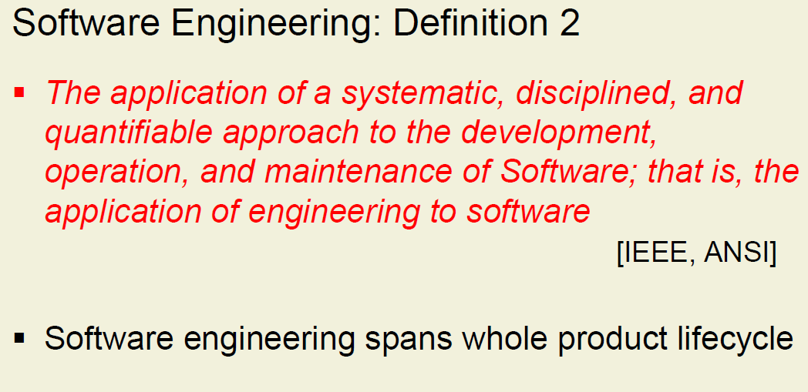
Software Engineering_Def_IEEE
Peter Müller ETH Zurich – SS-06

Slide 7
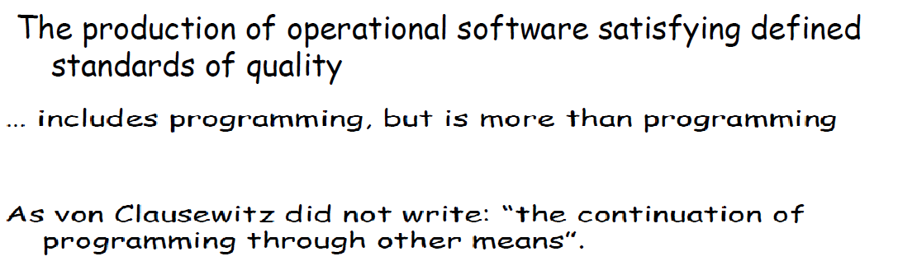
Software Engineering Def_Meyer
Bertrand Meyer ETH Zurich – SE

Slide 8
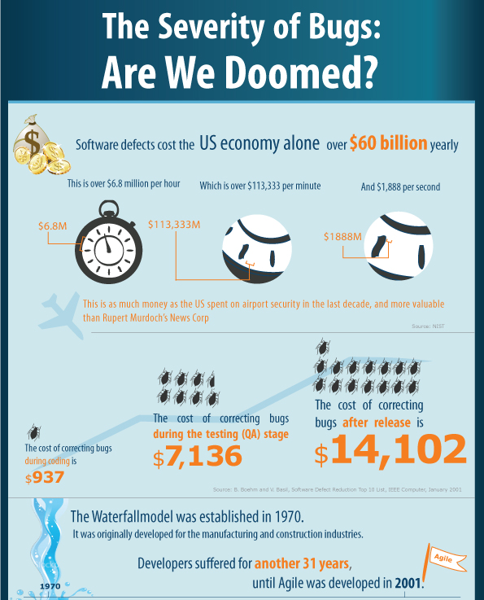
The costs of software errors

Slide 9
The costs of software errors…update
In 2002, software bugs cost the United States economy approximately $59.5 billion (Software).
In 2016, that number jumped to $1.1 trillion (1 trillion = 1000 billion)
In summary, the cost of poor-quality software in the US in 2018 is approximately $2.84 trillion. If we remove the future cost of technical debt, the total becomes $2.26 trillion.
The report states that the cost of poor software quality in the U.S. was approximately $2.08 trillion in 2020

Slide 10
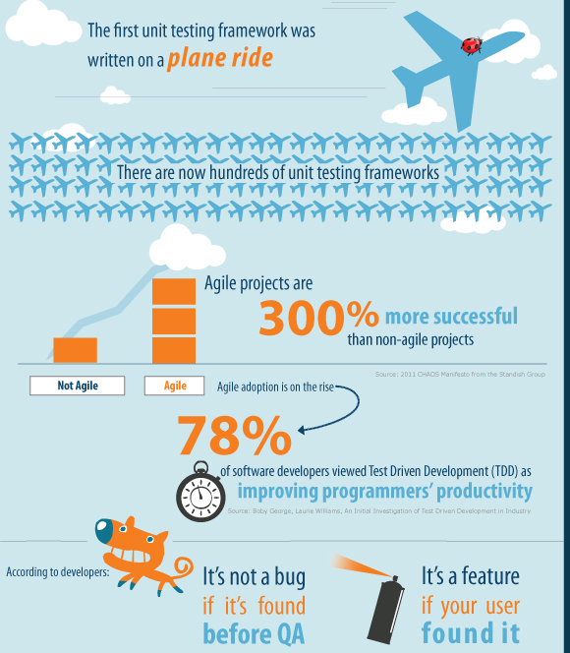
The costs of software errors_2

Slide 11
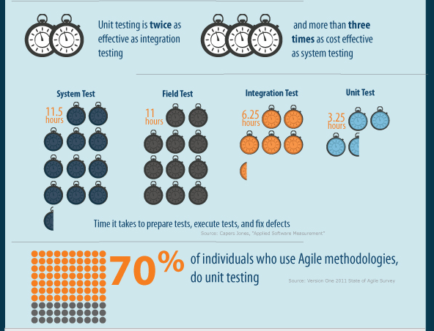
The costs of software errors_3
The Severity of Bugs, Are We Doomed?
The Cost of Bugs
Is Anyone Hiring Programmers?

Slide 12
What the customer really needed a funny explanation of it written by Phil Hord
How the customer explained it. The customer usually has no clue what he really needs. He thinks he does, but he can also think of extra features he’ll never use. He’ll demand them up front, because he’s afraid he won’t get them added later.
How the project leader understood it. The guy in charge of the project usually gets some critical detail wrong. It’s often wrong in a way that makes it useless, but it snowballs from there into comedy.
How the analyst designed it. The analyst has to decide how to fix the leader’s misunderstanding of the project. A common “fix” is to break something else to work with our existing design.

Slide 13
What the customer really needed_2 a funny explanation of it written by Phil Hord
How the programmer wrote it. Programmers are notorious for not understanding the essential features of a project. They implement things quite literally, sometimes.
How the business consultant described it. Marketing folks are the engineers’ nightmares. They sell the customer on the glowing, cushy features of this project, paying no attention to the truth or practicality of the situation.
How the project was documented. Documentation is usually an afterthought, or an I-thought. As in, I thought someone else was writing it.

Slide 14
What the customer really needed_3 a funny explanation of it written by Phil Hord
What operations installed. Sometimes we spend months getting certain features to work, only to find out later that those features were never installed at the customer site because A) they didn’t work, B) the installer didn’t understand how it worked, or C) someone was afraid the fixes were no good.
How the customer was billed. Yeah, software is expensive. We get to charge for all our clueless machinations.
How it was supported. “Is this feature causing the customer to call tech support? Perhaps we should remove it.” Eventually, you end up with the basic stub of the project.
What the customer really needed. It would be so much easier if we could ever get to this simple starting point. But we never do…

Slide 15
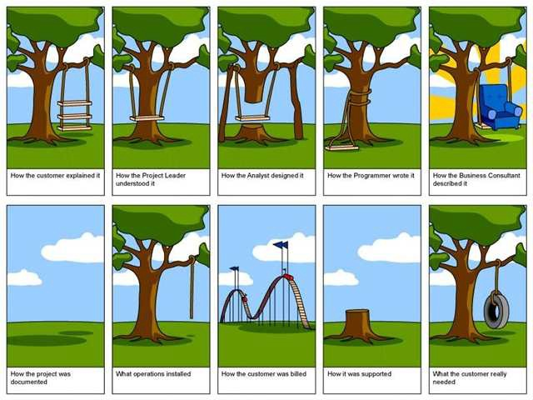
The costs of software errors_4
What the customer really needed
When model specification process is hasty ... rationales:

Slide 16
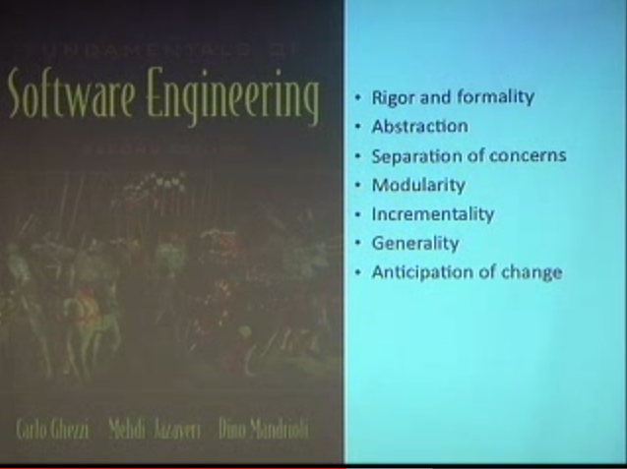
Software Engineering Principles
Carlo Ghezzi, Mehdi Jazayeri and Dino Mandrioli
see What can we learn from software engineering and why?.

Slide 17
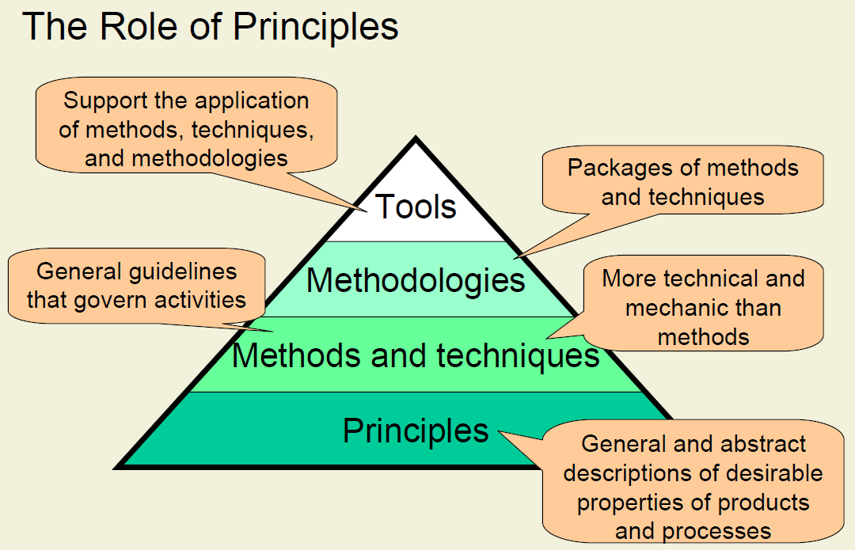
Software Engineering Principles_2
Peter Müller ETH Zurich – SS-06

Slide 18
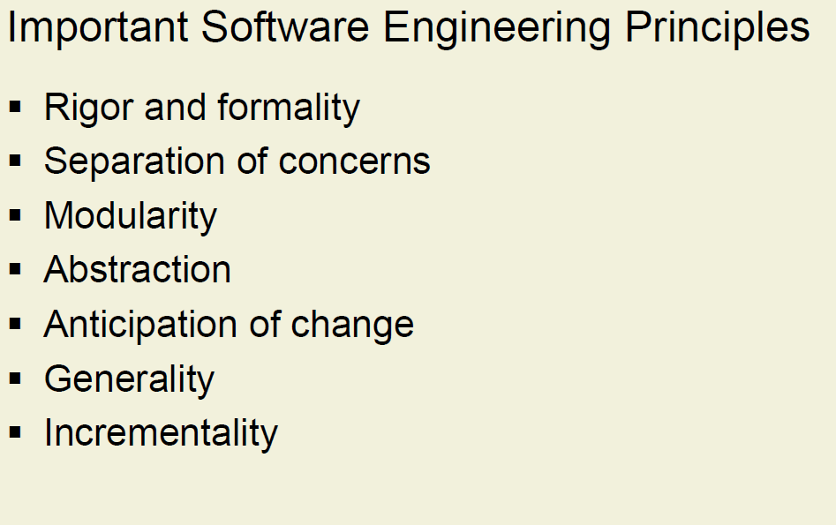
Software Engineering Principles_3
Peter Müller ETH Zurich – SS-06

Slide 19
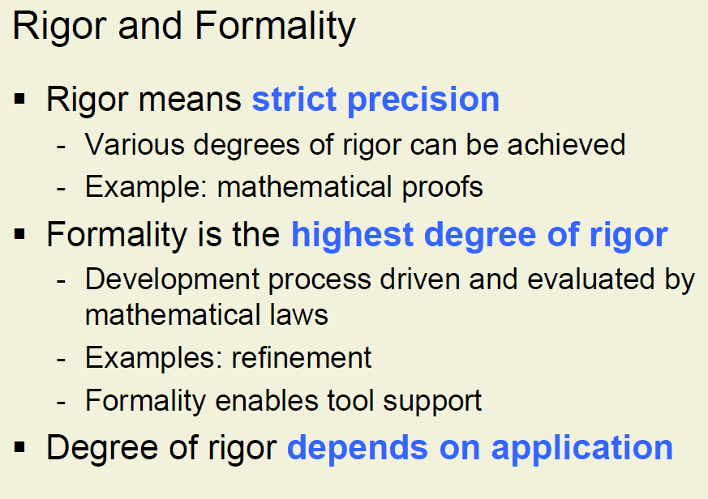
Software Engineering Principles_4
Peter Müller ETH Zurich – SS-06

Slide 20
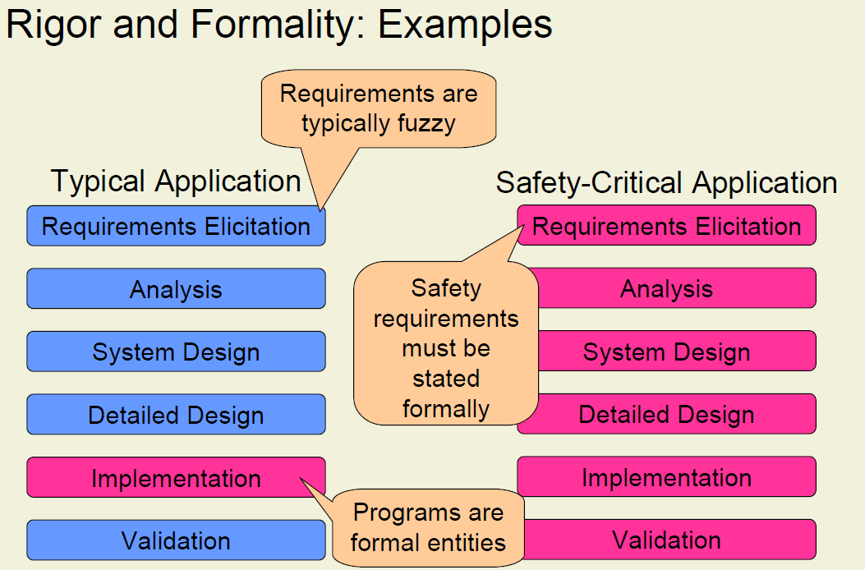
Software Engineering Principles_5
Peter Müller ETH Zurich – SS-06

Slide 21
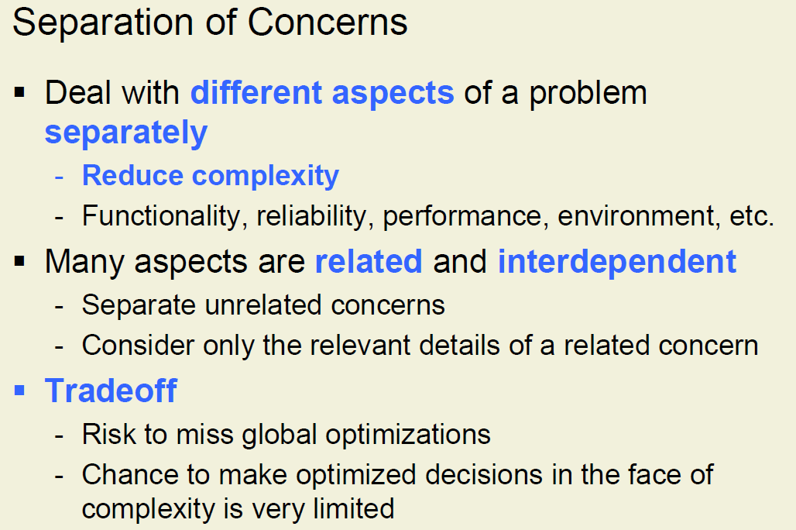
Software Engineering Principles_7
https://en.wikipedia.org/wiki/Separation_of_concerns
Peter Müller ETH Zurich – SS-06

Slide 22
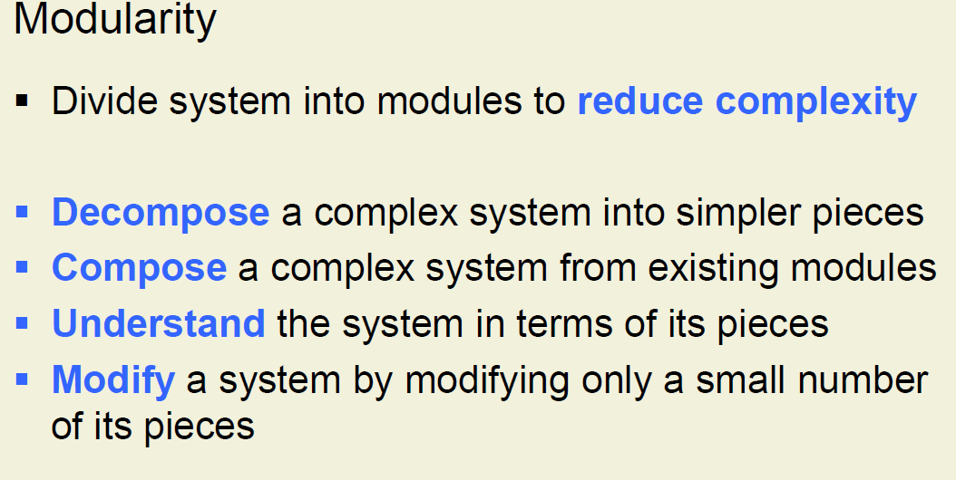
Software Engineering Principles_7
Peter Müller ETH Zurich – SS-06

Slide 23
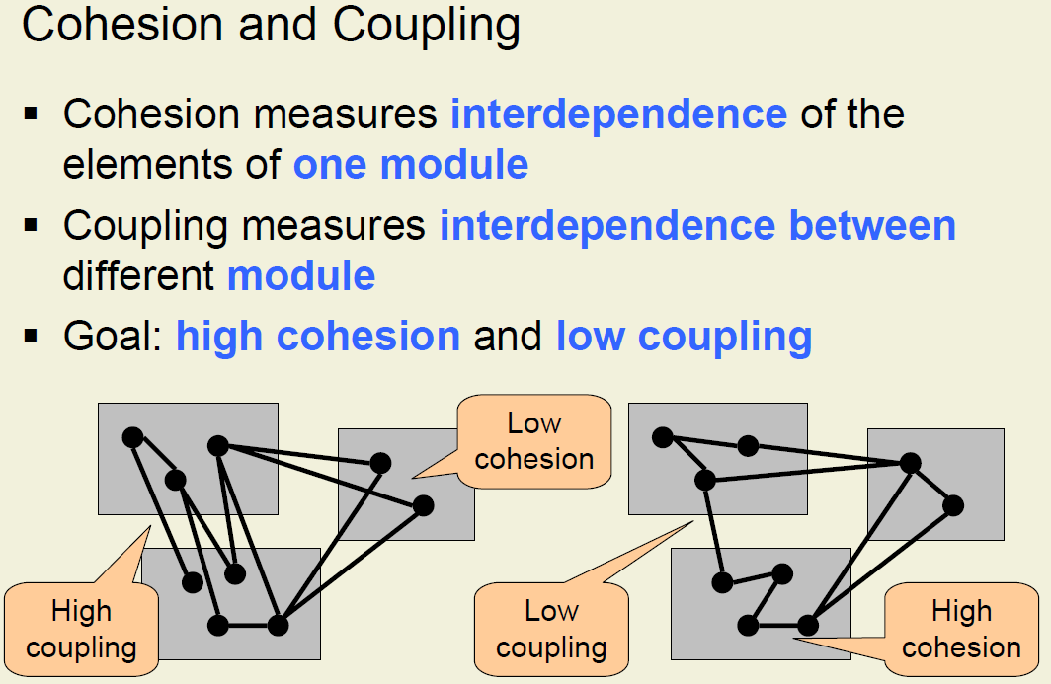
Software Engineering Principles_8
Peter Müller ETH Zurich – SS-06

Slide 24
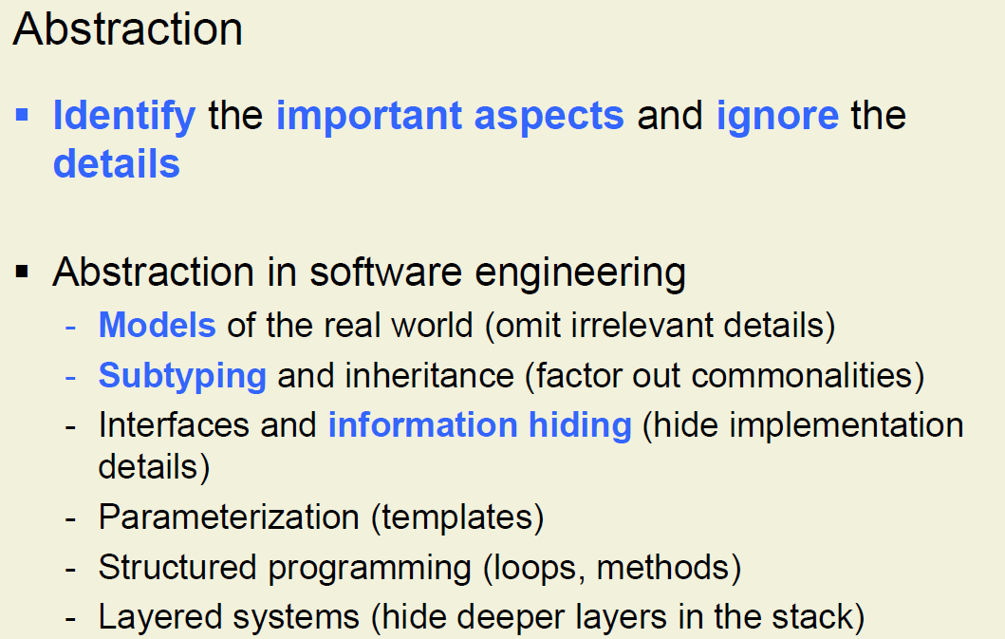
Software Engineering Principles_9
Peter Müller ETH Zurich – SS-06

Slide 25
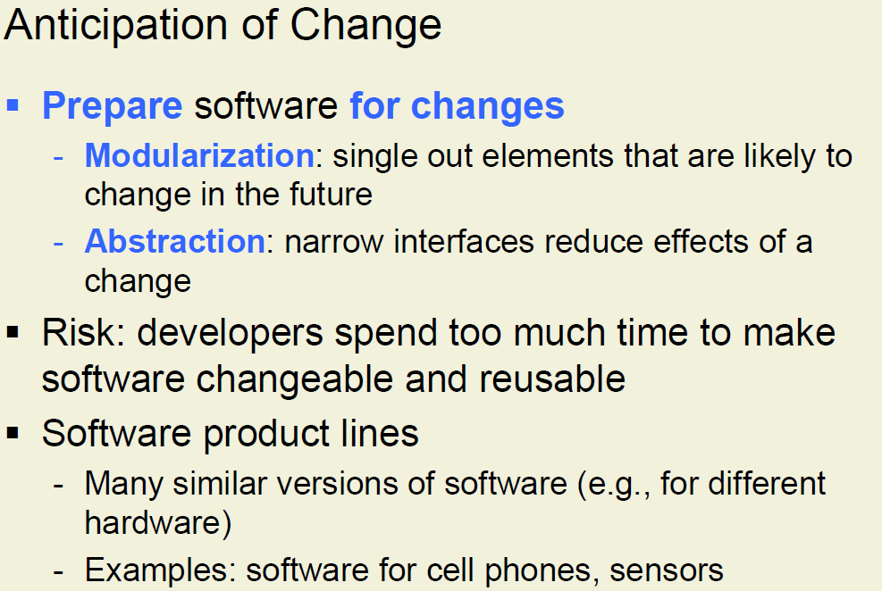
Software Engineering Principles_10
Peter Müller ETH Zurich – SS-06

Slide 26
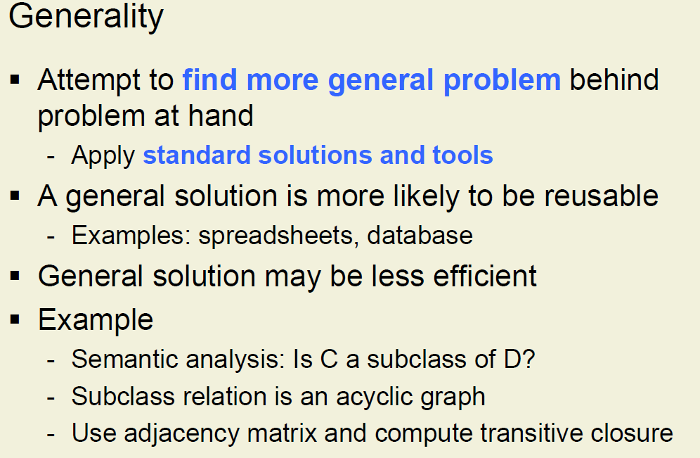
Software Engineering Principles_11
Peter Müller ETH Zurich – SS-06

Slide 27
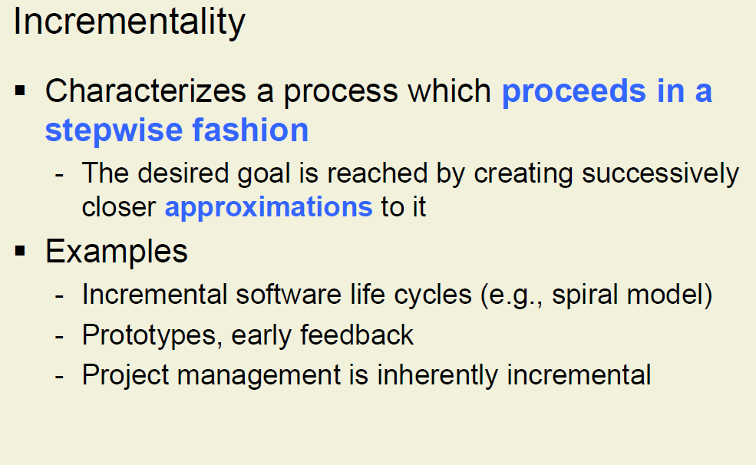
Software Engineering Principles_12
Peter Müller ETH Zurich – SS-06

Slide 28
What is Software Engineering?
Software engineering is a modeling activity.
Software engineers deal with complexity through modeling, by focusing at any one time on only the relevant details and ignoring everything else.
In the course of development, software engineers build many different models of the system and of the application domain.

Slide 29
What is Software Engineering?_2
SE is a problem-solving activity. Models are used to search for an acceptable solution. This search is driven by experimentation.
Software engineers do not have infinite resources and are constrained by budget and deadlines. Given the lack of a fundamental theory, they often rely on empirical methods to evaluate the benefits of different alternatives.

Slide 30
What is Software Engineering?_3
SE is a knowledge acquisition activity.
In modeling the application and solution domain, software engineers collect data, organize it into information, and formalize it into knowledge.
Knowledge acquisition is not sequential, as a single piece of additional data can invalidate complete models.

Slide 31
What is Software Engineering?_4
SE is a rationale-driven activity.
When acquiring knowledge and making decisions about the system or its application domain, software engineers also need to capture the context in which decisions were made and the rationale behind these decisions. Rationale information, represented as a set of issue models, enables software engineers to understand the implication of a proposed change when revisiting a decision. We assume that change can occur at any time.

Slide 32
Modeling
One of the basic methods of science.
A model is an abstract representation of a system that enables us to answer questions about the system.
Models are useful when dealing with systems that are too large, too small, too complicated, or too expensive to experience firsthand, but not only. ☺
Models also allow us to visualize and understand systems that either no longer exist or that are only claimed to exist.

Slide 33
Modeling_2
Software engineers need to:
understand the systems they could build,
evaluate different solutions and trade-offs.
Most systems are too complex to be understood by any one person, and most systems are expensive to build.
To address these challenges, software engineers describe important aspects of the alternative systems they investigate. In other terms, they need to build a model of the solution domain.

Slide 34
Modeling_3
Object-oriented methods combine the application domain and solution domain modeling activities into one.
The application domain is first modeled as a set of objects and relationships. This model is then used by the system to represent the real-world concepts it manipulates. (A train traffic control system includes train objects representing the trains it monitors. A stock trading system includes transaction objects representing the buying and selling of commodities.)
Then, solution domain concepts are also modeled as objects.

Slide 35
Modeling_4
The idea of object-oriented methods is that the solution domain model is a transformation of the application domain model.
Developing software translates into the activities necessary to identify and describe a system as a set of models that addresses the end user’s problem.

Slide 36
Problem solving
Engineering is a problem-solving activity. Engineers search for an appropriate solution, often by:
trial and error,
evaluating alternatives empirically,
with limited resources and incomplete knowledge.
In its simplest form, the engineering method includes:
Formulate the problem.
Analyze the problem.
Search for solutions.
Decide on the appropriate solution.
Specify the solution.

Slide 37
Problem solving_2
Software engineering is an engineering activity, it is not algorithmic. SE requires:
experimentation,
the reuse of pattern solutions,
the incremental evolution of the system.
Object-oriented software development typically includes:
requirements elicitation,
analysis,
system design,
object design,
implementation,
testing

Slide 38
Problem solving_3
Software development also includes activities whose purpose is to evaluate the appropriateness of the respective models.
During the analysis review, the application domain model is compared with the client’s reality, which in turn might change as a result of modeling.
During the design review, the solution domain model is evaluated against project goals.

Slide 39
Problem solving_4
During testing, the system is validated against the solution domain model, which might be changed by the introduction of new technologies.
During project management, managers compare their model of the development process (i.e., the project schedule and budget) against reality (i.e., the delivered work products and expended resources).

Slide 40
Knowledge acquisition
A common mistake that software engineers and managers make is to assume that the acquisition of knowledge needed to develop a system is linear.
Knowledge acquisition is a nonlinear process. The addition of a new piece of information may invalidate all the knowledge we have acquired for the understanding of a system. Even if we had already documented this understanding in documents and code (“The system is 90% coded, we will be done next week”), we must be mentally prepared to start from scratch.

Slide 41
Knowledge acquisition_2
There are several software processes that deal with this problem by avoiding the sequential dependencies inherent in the waterfall model.
Risk-based development attempts to anticipate surprises late in a project by identifying the high-risk components. Issue-based development attempts to remove the linearity altogether.
Any development activity: analysis, system design, object design, implementation, testing, or delivery; can influence any other activity. In issue-based development, all these activities are executed in parallel.

Slide 42
Rationale
Assumptions that developers make about a system change constantly. Design and implementation faults discovered during testing and usability problems discovered during user evaluation trigger changes to the solution models. Changes can also be caused by new technology.
A typical task of software engineers is to change a currently operational software system to incorporate this new enabling technology.

Slide 43
Rationale_2
To change the system, it is not enough to understand its current components and behavior;
it is also necessary to capture and understand the context in which each design decision was made.
This additional knowledge is called the rationale of the system.
Capturing and accessing the rationale of a system is not trivial. For every decision made, several alternatives may have been considered, evaluated, and argued.

Slide 44
Rationale_3
Rationale represents a much larger amount of information than do the solution models. Rationale information is often not explicit.
Developers make many decisions based on their experience and their intuition, without explicitly evaluating different alternatives. When asked to explain a decision, developers may have to spend a substantial amount of time recovering its rationale.
In order to deal with changing systems, software engineers must address the challenges of capturing and accessing rationale.

Slide 45
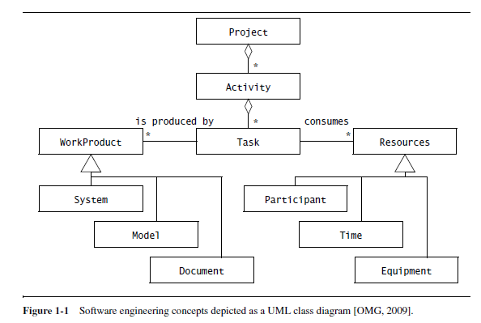
Software Engineering Concepts
The project purpose is to develop a software system

Slide 46
Participants and Roles
Developing a software system requires the collaboration of many people with different backgrounds and interests:
the client orders and pays for the system,
the developers construct the system,
the project manager plans and budgets the project and coordinates the developers and the client,
the end users are supported by the system.

Slide 47
Participants and Roles_2
We refer to all the persons involved in the project as participants.
We refer to a set of responsibilities in the project or the system as a role.
A role is associated with a set of tasks and is assigned to a participant. The same participant can fulfill multiple roles.

Slide 48
Participants and Roles_3
TicketDistributor is a machine that distributes tickets for trains. Travelers have the option of selecting a ticket for a single trip or for multiple trips, or selecting a timecard for a day or a week.
The TicketDistributor computes the price of the requested ticket based on the area in which the trip will take place and whether the traveler is a child or an adult.
The TicketDistributor must be able to handle several exceptions, such as travelers who do not complete the transaction, travelers who attempt to pay with large bills, and resource outages, such as running out of tickets, change, or power.

Slide 49
Systems & models
We use the term system as a collection of interconnected parts.
Modeling is a way to deal with complexity by ignoring irrelevant details. We use the term model to refer to any abstraction of the system.
A TicketDistributor for an underground train is a system.
Blueprints for the TicketDistributor, schematics of its electrical wiring, and object models of its software are models of the TicketDistributor

Slide 50
Systems & models_2
A development project is itself a system that can be modeled.
The project schedule, its budget, and its planned deadlines are models of the development project.

Slide 51
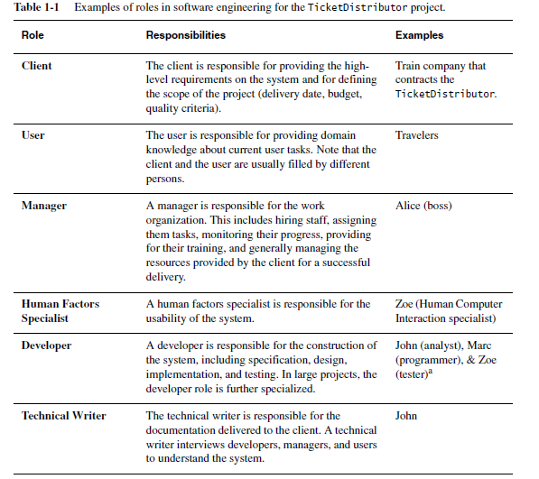
Example of roles in Software Engineering

Slide 52
Work products
A work product is an artifact that is produced during the development, such as a document or a piece of software for other developers or for the client.
We refer to a work product for the project’s internal consumption as an internal work product.
We refer to a work product that must be delivered to a client as a deliverable.
Deliverables are generally defined prior to the start of the project and specified by a contract binding the developers with the client.

Slide 53
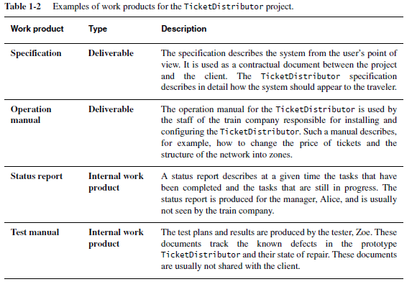
Work products_2

Slide 54
Activities, Tasks, and Resources
Activity - a set of tasks that is performed toward a specific purpose. For example:
requirements elicitation is an activity whose purpose is to define with the client what the system will do,
delivery is an activity whose purpose is to install the system at an operational location,
management is an activity whose purpose is to monitor and control the project such that it meets its goals (e.g., deadline, quality, budget).

Slide 55
Activities, Tasks, and Resources_2
Activities can be composed of other activities. The delivery activity includes a software installation activity and an operator training activity. Activities are also sometimes called phases.
A task represents an atomic unit of work that can be managed. A manager assigns it to a developer, the developer carries it out, and the manager monitors the progress and completion of the task. Tasks consume resources, result in work products, and depend on work products produced by other tasks.

Slide 56
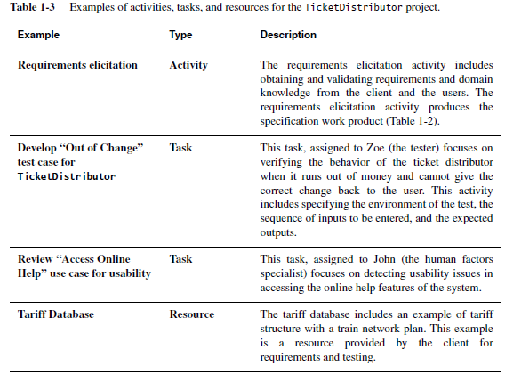
Activities, Tasks, and Resources_3

Slide 57
Functional and non Functional Requirements
Requirements specify a set of features that the system must have.
A functional requirement is a specification of a function that the system must support;
a nonfunctional requirement is a constraint on the operation of the system that is not related directly to a function of the system.

Slide 58
Functional and non Functional Requirements_2
Functional requirements:
the user must be able to purchase tickets
the user must be able to access tariff information
Nonfunctional requirements:
the user must be provided feedback in less than one second
the colors used in the interface should be consistent with the company colors

Slide 59
Methods, and Methodologies
Modeling language/notation
A method is a repeatable technique that specifies the steps involved in solving a specific problem. Examples:
a recipe is a method for cooking a specific dish,
a sorting algorithm is a method for ordering elements of a list,
rationale management is a method for justifying change,
configuration management is a method for tracking change.

Slide 60
Methods, and Methodologies_2
A methodology is a collection of methods for solving a class of problems and specifies how and when each method should be used.
A seafood cookbook with a collection of recipes is a methodology for preparing seafood if it also contains advices on how ingredients should be used and what to do if not all ingredients are available.

Slide 61
Software Engineering Development Activities
Development activities deal with the complexity by constructing and validating models of the application domain or the system.
Development activities include:
Requirements Elicitation
Analysis
System Design
Object Design
Implementation
Testing

Slide 62
Software Engineering Development Activities_2
Requirements Elicitation
During requirements elicitation, the client and developers define the purpose of the system. The result of this activity is a description of the system in terms of actors and use cases. Actors represent the external entities that interact with the system.

Slide 63
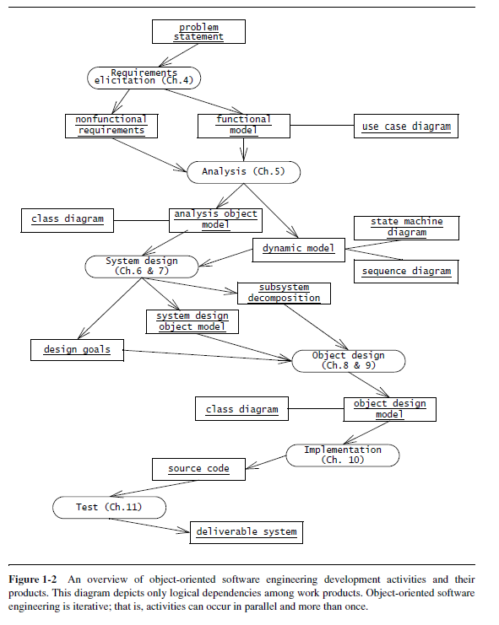
Software Engineering Development Activities_3

Slide 64
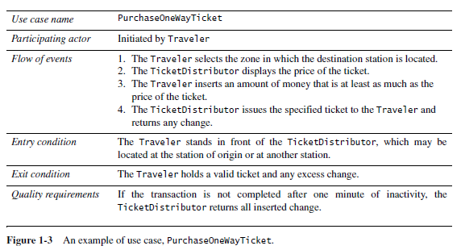
Software Engineering Development Activities_4

Slide 65
Software Engineering Development Activities_5
Analysis
Developers:
aim to produce a model of the system that is correct, complete, consistent, and unambiguous,
transform the use cases produced during requirements elicitation into an object model that completely describes the system,
discover ambiguities and inconsistencies in the use case model that they resolve with the client.

Slide 66
Software Engineering Development Activities_6
Analysis
The result of analysis is a system model annotated with attributes, operations, and associations.
The system model can be described in terms of its structure and its dynamic interoperation.

Slide 67
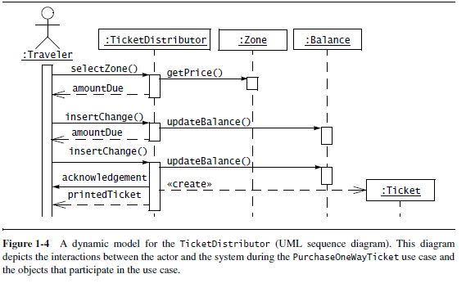
Software Engineering Development Activities_7

Slide 68
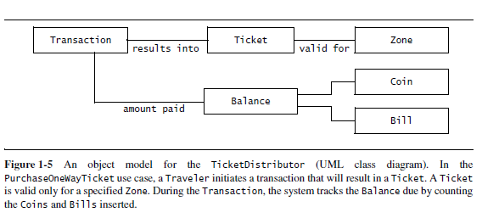
Software Engineering Development Activities_8

Slide 69
Software Engineering Development Activities_9
System Design
Developers:
define the design goals of the project and decompose the system into smaller subsystems that can be realized by individual teams,
select strategies for building the system, such as the hardware/software platform on which the system will run, the persistent data management strategy, the global control flow, the access control policy, and the handling of boundary conditions.

Slide 70
Software Engineering Development Activities_10
System Design
⇒ a clear description of each of these strategies, a subsystem decomposition, and a deployment diagram representing the hardware/software mapping of the system.
Whereas both analysis and system design produce models of the system under construction, only analysis deals with entities that the client can understand.

Slide 71
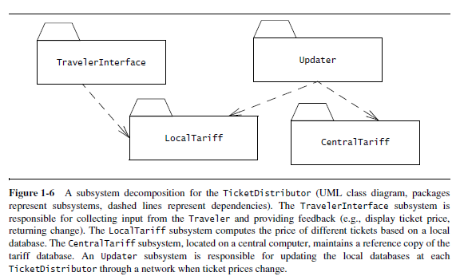
Software Engineering Development Activities_11

Slide 72
Software Engineering Development Activities_12
Object Design
developers define solution domain objects to bridge the gap between the analysis model and the hardware/software platform defined during system design. This includes:
precisely describing object and subsystem interfaces,
selecting off-the-shelf components,
restructuring the object model to attain design goals such as extensibility or understandability,
optimizing the object model for performance.

Slide 73
Software Engineering Development Activities_13
The result of the object design activity is a detailed object model annotated with constraints and precise descriptions for each element.
Implementation
developers translate the solution domain model into source code. This includes implementing the attributes and methods of each object and integrating all the objects such that they function as a single system.
spans the gap between the detailed object design model and a complete set of source code files that can be compiled.

Slide 74
Software Engineering Development Activities_14
Testing
developers find differences between the system and its models by executing the system (or parts of it) with sample input data sets.
unit testing, developers compare the object design model with each object and subsystem.
integration testing, combinations of subsystems are integrated together and compared with the system design model.

Slide 75
Software Engineering Development Activities_15
Testing
system testing, typical and exception cases are run through the system and compared with the requirements model.
The goal of testing is to discover as many faults as possible such that they can be repaired before the delivery of the system. The planning of test phases occurs in parallel to the other development activities.

Slide 76
Managing Software Development
Management activities focus on:
planning the project,
monitoring its status,
tracking changes,
coordinating resources
such that a high-quality product is delivered on time and within budget.
Management activities not only involve managers, but also most of the other project participants as well.

Slide 77
Managing Software Development_2
Management activities include:
Communication
Rationale Management
Software Configuration Management
Project Management
Software Life Cycle
As modern software engineering projects become more change driven, the distinction between construction activities and maintenance activities is blurred.

Slide 78
Managing Software Development_3
Communication
is the most critical and time-consuming activity in software engineering. Misunderstandings and omissions often lead to faults and delays that are expensive to correct later in the development,
includes the exchange of models and documents about the system and its application domain, reporting the status of work products, providing feedback on the quality of work products, raising and negotiating issues, and communicating decisions.

Slide 79
References
Bernd Bruegge & Allen H. Dutoit - Object-Oriented Software Engineering Using UML, Patterns, and Java – Third Edition – Prentice Hall 2010
Ian Sommerville – Software Engineering - Ninth Edition – Addison Wesley 2011
Ivan Marsic –Software Engineering - Rutgers University, New Brunswick, New Jersey 2012

Slide 80
Evaluation
Course - written exam - 60%
Optional:
Partial (half semester) evaluation ?
Seminar/lab activities - 40%

Slide 81
Lab activities - Evaluation
Lab is focused on:
small teams working to develop software,
usage of models in all phases of software life cycle,
using appropriate tools in model construction, validation and code generation
constructing rigorous models complying with the requirements, design and implementation,
usage of design patterns,
code generation, viewed as model transformation,
system testing,
Teachers will discuss with all team-members about expected deliverables for the current lab

Slide 82
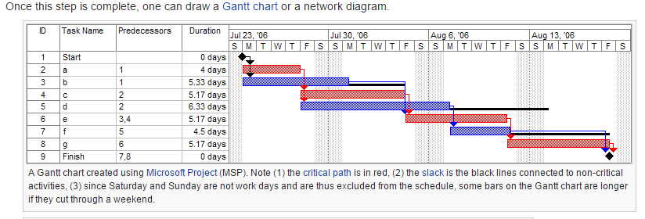
Program (project) evaluation and review technique, (PERT)

Slide 83
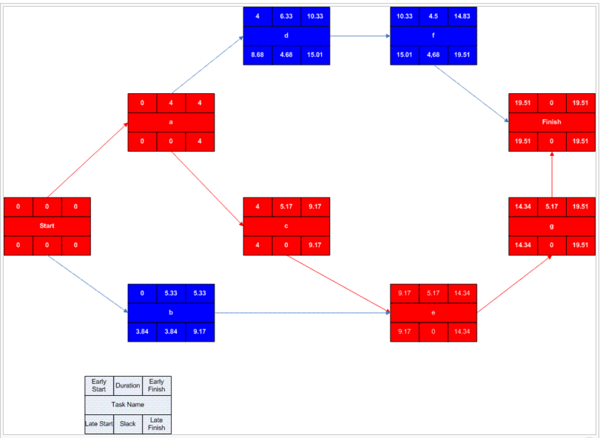
Critical Path Method (CPM) – Microsoft Visio

Slide 84
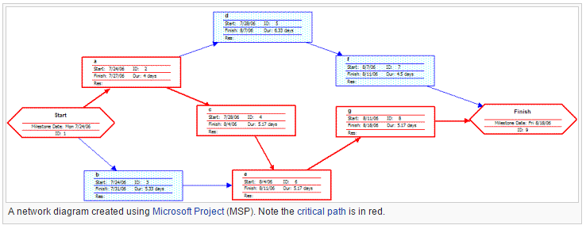
Critical Path Method (CPM) – realized with MSP

Slide 85
Thanks for your patience!

